Slide 1

Custom Model building with SQL in BigQuery ML

Slide 2

Agenda
BigQuery ML for Quick Model Building
Supported Models

Slide 3
















BigQuery ML is a way to build custom models
Build a Custom Model
Build Custom Model (codeless)
Call a Pretrained Model
AutoML
Cloud TPUs
Compute Engine
Cloud Translation API
Cloud Vision API
Cloud Speech API
Cloud Video
Intelligence API
Data Loss Prevention API
Cloud Speech Synthesis API
Cloud Natural Language API
Cloud Dataproc
Kubernetes Engine
Cloud AI Platform
BigQuery ML
Dialogflow

Slide 4
Working with BigQuery ML
Evaluate model and verify that it meets requirements
Predict using model on data extracted from BigQuery
Create a model, specifying model type
Write SQL query to extract training data from BigQuery
1
2
3
4

Slide 5

Working with BigQuery ML
FROM
ML.EVALUATE(MODEL `bqml_tutorial.sample_model`,
TABLE eval_table)
1
Dataset
2
Create/train
3
Evaluate
4
Predict/classify
CREATE MODEL `bqml_tutorial.sample_model`
OPTIONS(model_type='logistic_reg') AS
SELECT
FROM
ML.PREDICT(MODEL `bqml_tutorial.sample_model`,
table game_to_predict) ) AS predict

Slide 6
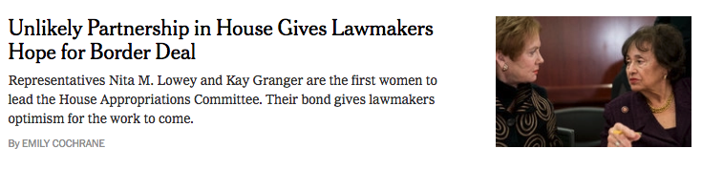

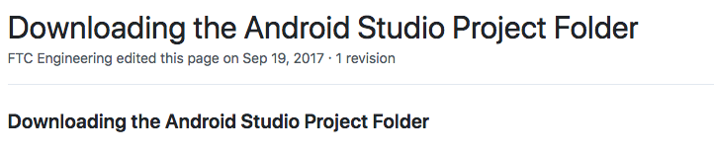
Where was this article published?
1
Techcrunch
GitHub
NY Times
2
3

Slide 7
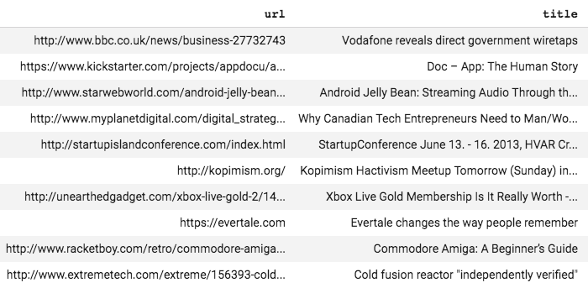
SQL query to extract data
*no clusters, no indexes, ad hoc query!
SELECT
url, title
FROM
`bigquery-public-data.hacker_news.stories`
WHERE
LENGTH(title) > 10
AND LENGTH(url) > 0
LIMIT 10
Notes:
SELECT
url, title
FROM
`bigquery-public-data.hacker_news.stories`
WHERE
LENGTH(title) > 10
AND LENGTH(url) > 0
LIMIT 10

Slide 8
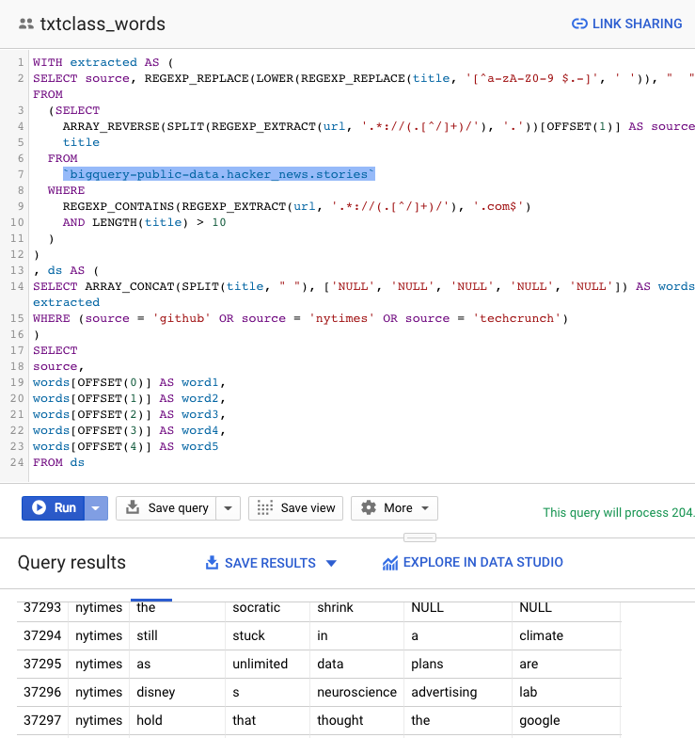
Use regex to get source + train on words of title
https://console.cloud.google.com/bigquery?sq=711916710713:47df84978c64458ea04b3cb4ae5de878
Notes:
WITH extracted AS (
SELECT source, REGEXP_REPLACE(LOWER(REGEXP_REPLACE(title, '[^a-zA-Z0-9 $.-]', ' ')), " ", " ") AS title FROM
(SELECT
ARRAY_REVERSE(SPLIT(REGEXP_EXTRACT(url, '.*://(.[^/]+)/'), '.'))[OFFSET(1)] AS source,
title
FROM
`bigquery-public-data.hacker_news.stories`
WHERE
REGEXP_CONTAINS(REGEXP_EXTRACT(url, '.*://(.[^/]+)/'), '.com$')
AND LENGTH(title) > 10
)
)
, ds AS (
SELECT ARRAY_CONCAT(SPLIT(title, " "), ['NULL', 'NULL', 'NULL', 'NULL', 'NULL']) AS words, source FROM extracted
WHERE (source = 'github' OR source = 'nytimes' OR source = 'techcrunch')
)
SELECT
source,
words[OFFSET(0)] AS word1,
words[OFFSET(1)] AS word2,
words[OFFSET(2)] AS word3,
words[OFFSET(3)] AS word4,
words[OFFSET(4)] AS word5
FROM ds

Slide 9
Create model
CREATE OR REPLACE MODEL advdata.txtclass
OPTIONS(model_type='logistic_reg', input_label_cols=['source'])
AS
WITH extracted AS (
...
)
, ds AS (
SELECT ARRAY_CONCAT(SPLIT(title, " "), ['NULL', 'NULL', 'NULL', 'NULL', 'NULL']) AS words, source FROM extracted
WHERE (source = 'github' OR source = 'nytimes' OR source = 'techcrunch')
)
SELECT
source,
words[OFFSET(0)] AS word1,
words[OFFSET(1)] AS word2,
words[OFFSET(2)] AS word3,
words[OFFSET(3)] AS word4,
words[OFFSET(4)] AS word5
FROM ds
Query to extract training data
Notes:
A model feels like just another table that is being created.

Slide 10
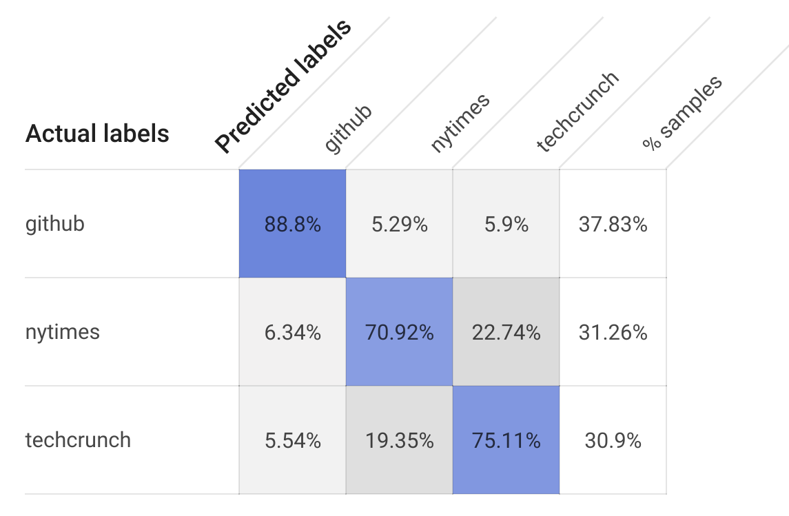
Evaluate model
SELECT * FROM ML.EVALUATE(MODEL advdata.txtclass)
precision | recall | accuracy | f1_score | log_loss | roc_auc
0.783 | 0.783 | 0.79 | 0.783 | 0.858 | 0.918
(BQML splits the training data and reports evaluation statistics on the held-out set)
Notes:
SELECT * FROM ML.EVALUATE(MODEL advdata.txtclass)

Slide 11
Predict using trained model
SELECT * FROM ML.PREDICT(MODEL advdata.txtclass,(
SELECT 'government' AS word1, 'shutdown' AS word2, 'leaves' AS word3, 'workers' AS word4, 'reeling' AS word5
UNION ALL SELECT 'unlikely', 'partnership', 'in', 'house', 'gives'
UNION ALL SELECT 'fitbit', 's', 'fitness', 'tracker', 'is'
UNION ALL SELECT 'downloading', 'the', 'android', 'studio', 'project'
))
Row | predicted_source | word1 | word2 | word3 | word4 | word5
1 | nytimes | government | shutdown | leaves | workers | reeling
2 | nytimes | unlikely | partnership | in | house | gives
3 | techcrunch | fitbit | s | fitness | tracker | is
4 | techcrunch | downloading | the | android | studio | project
“Batch prediction”
https://console.cloud.google.com/bigquery?sq=663413318684:4d854a43ae93416eaeb349e1fc4888cb
Notes:
SELECT * FROM ML.PREDICT(MODEL advdata.txtclass,(
SELECT 'government' AS word1, 'shutdown' AS word2, 'leaves' AS word3, 'workers' AS word4, 'reeling' AS word5
UNION ALL SELECT 'unlikely', 'partnership', 'in', 'house', 'gives'
UNION ALL SELECT 'fitbit', 's', 'fitness', 'tracker', 'is'
UNION ALL SELECT 'downloading', 'the', 'android', 'studio', 'project'
))

Slide 12
Demo: Train a model with BigQuery ML to predict NYC taxi fares
Notes:
Demo Instructions: https://github.com/GoogleCloudPlatform/training-data-analyst/blob/master/courses/data-engineering/demos/predict_taxi_bigqueryml.md

Slide 13
Agenda
BigQuery ML for Quick Model Building
Supported Models

Slide 14
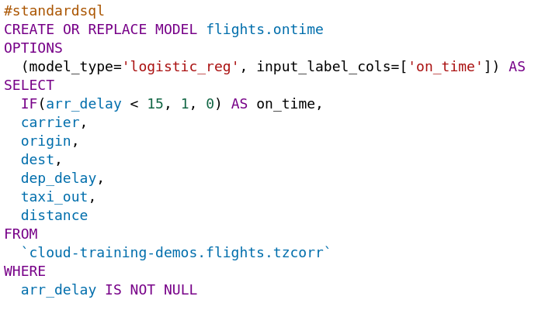
Linear Classifier (Logistic regression)
Notes:
Show them running this model (If so, be sure and create a flights dataset first in US)
QUERY:
#standardsql
CREATE OR REPLACE MODEL flights.ontime
OPTIONS
(model_type='logistic_reg', input_label_cols=['on_time']) AS
SELECT
IF(arr_delay < 15, 1, 0) AS on_time,
carrier,
origin,
dest,
dep_delay,
taxi_out,
distance
FROM
`cloud-training-demos.flights.tzcorr`
WHERE
arr_delay IS NOT NULL

Slide 15
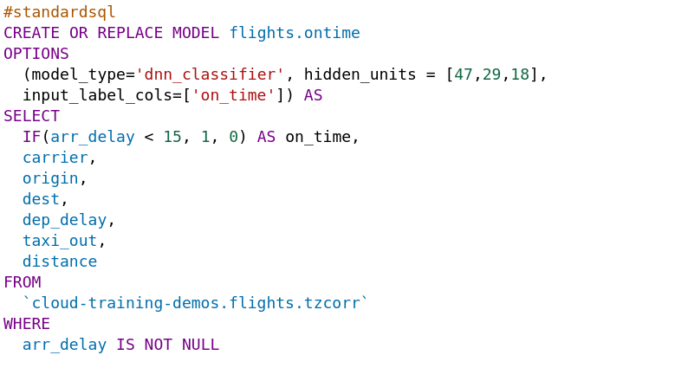
DNN Classifier (alpha)
Notes:
Show them running this model
QUERY:
#standardsql
CREATE OR REPLACE MODEL flights.ontime
OPTIONS
(model_type='dnn_classifier', hidden_units = [47,29,18],
input_label_cols=['on_time']) AS
SELECT
IF(arr_delay < 15, 1, 0) AS on_time,
carrier,
origin,
dest,
dep_delay,
taxi_out,
distance
FROM
`cloud-training-demos.flights.tzcorr`
WHERE
arr_delay IS NOT NULL

Slide 16
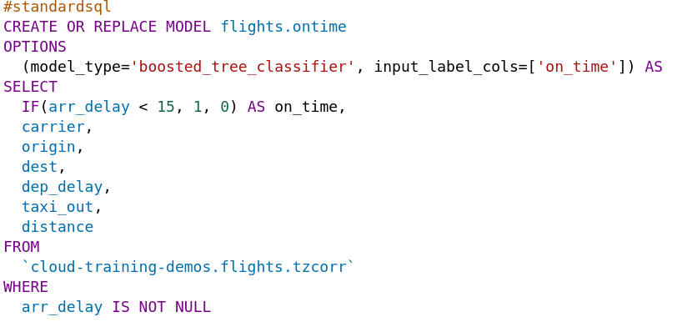
xgboost Classifier (alpha)
Notes:
Show them running this model
QUERY:
#standardsql
CREATE OR REPLACE MODEL flights.ontime
OPTIONS
(model_type='boosted_tree_classifier’', input_label_cols=['on_time']) AS
SELECT
IF(arr_delay < 15, 1, 0) AS on_time,
carrier,
origin,
dest,
dep_delay,
taxi_out,
distance
FROM
`cloud-training-demos.flights.tzcorr`
WHERE
arr_delay IS NOT NULL

Slide 17
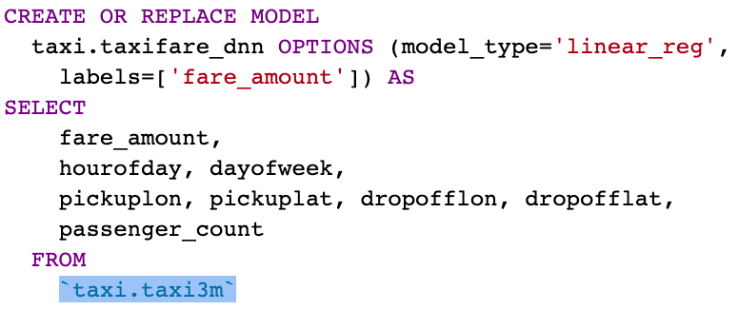
Linear Regression
Notes:
CREATE OR REPLACE MODEL
taxi.taxifare_dnn OPTIONS (model_type='linear_regressor',
labels=['fare_amount']) AS
SELECT
fare_amount,
hourofday, dayofweek,
pickuplon, pickuplat, dropofflon, dropofflat,
passenger_count
FROM
`taxi.taxi3m`

Slide 18
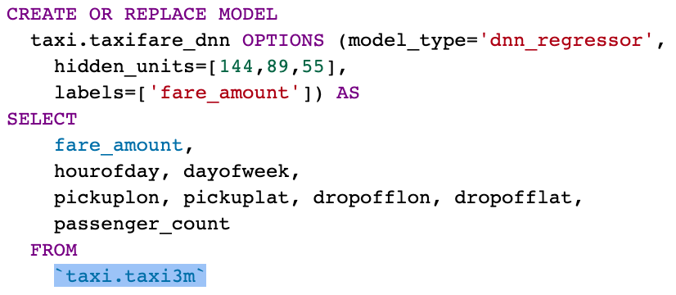
DNN Regression (alpha)
Notes:
CREATE OR REPLACE MODEL
taxi.taxifare_dnn OPTIONS (model_type='dnn_regressor',
hidden_units=[144,89,55],
labels=['fare_amount']) AS
SELECT
fare_amount,
hourofday, dayofweek,
pickuplon, pickuplat, dropofflon, dropofflat,
passenger_count
FROM
`taxi.taxi3m`

Slide 19
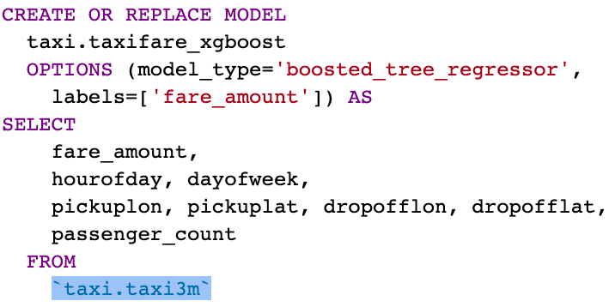
xgboost Regression (alpha)
Notes:
CREATE OR REPLACE MODEL
taxi.taxifare_xgboost
OPTIONS (model_type='boosted_tree_regressor',
labels=['fare_amount']) AS
SELECT
fare_amount,
hourofday, dayofweek,
pickuplon, pickuplat, dropofflon, dropofflat,
passenger_count
FROM
`taxi.taxi3m`

Slide 20
Train on TF, predict with BigQuery
CREATE OR REPLACE MODEL advdata.txtclass_tf2
OPTIONS (model_type='tensorflow',
model_path='gs://cloud-training-demos-ml/txtcls/trained_finetune_native/export/exporter/1549825580/*')
SELECT
input,
(SELECT AS STRUCT(p, ['github', 'nytimes', 'techcrunch'][ORDINAL(s)]) prediction FROM
(SELECT p, ROW_NUMBER() OVER() AS s FROM
(SELECT * FROM UNNEST(dense_1) AS p))
ORDER BY p DESC LIMIT 1).*
FROM ML.PREDICT(MODEL advdata.txtclass_tf2,
(
SELECT 'Unlikely Partnership in House Gives Lawmakers Hope for Border Deal' AS input
UNION ALL SELECT "Fitbit\'s newest fitness tracker is just for employees and health insurance members"
UNION ALL SELECT "Show HN: Hello, a CLI tool for managing social media"
))

Slide 21
Recommendation engine (matrix factorization alpha)
create or replace model models.suggested_products_1or2_example
options(model_type='matrix_factorization',
user_col='user_id', item_col='product_id', rating_col='rating',
l2_reg=10)
AS
with purchases AS (
select product_id, user_id from
operations.orders_with_lines, unnest(order_lines)
),
total_purchases as (
select product_id, user_id, count(*) as numtimes
from purchases
group by product_id, user_id
)
select
product_id, user_id,
IF(numtimes < 2, 1, 2) AS rating
FROM total_purchases
Notes:
Show them running this model

Slide 22
So what do we recommend for a given set of users?
with users AS (
SELECT
user_id, count(*) as num_orders
from operations.orders_with_lines
group by user_id
order by num_orders desc
limit 10
),
products as (
select product_id, count(*) as num_orders
from operations.orders_with_lines, unnest(order_lines)
group by product_id
order by num_orders desc
limit 10
)
SELECT * FROM ML.PREDICT(MODEL models.suggested_products_1or2,
(SELECT user_id, product_id
FROM users, products)
)
Notes:
I’ll assume that we have s

Slide 23
So what do we recommend for a given set of users?
Row | predicted_rating | user_id | product_id
1 | 1.5746015507788755 | 101797 | 26209
2 | 1.8070705987455633 | 101797 | 13176
3 | 1.7171094544245578 | 101797 | 27845
4 | 1.9763373899260837 | 101797 | 47209
5 | 1.8659380090171271 | 101797 | 21137
6 | 1.721610848530093 | 101797 | 47766
7 | 1.9516130703939483 | 101797 | 21903
Notes:
I’ll assume that we have s

Slide 24
Clustering
CREATE OR REPLACE MODEL demos_eu.london_station_clusters
OPTIONS(model_type='kmeans', num_clusters=4, standardize_features = true) AS
WITH hs AS …,
stationstats AS …
SELECT * except(station_name, isweekday)
from stationstats
4 clusters (hardcoded)
Standardize features since different dynamic ranges
Remove the cluster “id” fields (keep just the attributes)

Slide 25
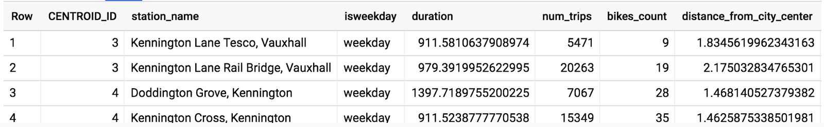
Which cluster?
WITH hs AS ...,
stationstats AS ...,
SELECT * except(nearest_centroids_distance)
FROM ML.PREDICT(MODEL demos_eu.london_station_clusters,
(SELECT * FROM stationstats WHERE REGEXP_CONTAINS(station_name, 'Kennington')))

Slide 26
Find cluster attributes
WITH T AS (
SELECT
centroid_id,
ARRAY_AGG(STRUCT(numerical_feature AS name, ROUND(feature_value,1) AS value) ORDER BY centroid_id) AS cluster
FROM ML.CENTROIDS(MODEL demos_eu.london_station_clusters)
GROUP BY centroid_id
)
SELECT
CONCAT('Cluster#', CAST(centroid_id AS STRING)) AS centroid,
(SELECT value from unnest(cluster) WHERE name = 'duration') AS duration,
(SELECT value from unnest(cluster) WHERE name = 'num_trips') AS num_trips,
(SELECT value from unnest(cluster) WHERE name = 'bikes_count') AS bikes_count,
(SELECT value from unnest(cluster) WHERE name = 'distance_from_city_center') AS distance_from_city_center
FROM T
ORDER BY centroid_id ASC

Slide 27
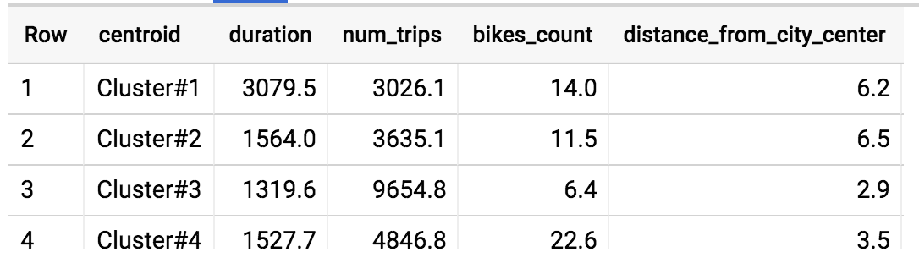
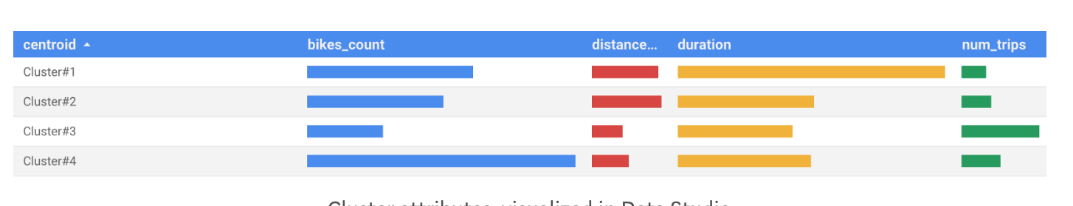
Visualize attributes in Data Studio ...

Slide 28

Use the transform clause
Inputs
Pre
processing
Feature
creation
Train
model
Trained Model
Same
Deploy
Ideally, call with input variables
Prediction
Clients
Model serving
Notes:
Notes:
Not as obvious … who will do the input transformations on behalf of the client code? You can’t pass in the raw input variables to the trained model -- it expects scaled, transformed inputs!
You also have to worry about model changes -- when you do a bag-of-words, for example, with IBM=32, the embedding might change in the next model run because your input data is larger. Similarly, in scaling, min/max/stdev can all change. Doing the bookkeeping associated with preprocessing and feature crosses is painful and a major source of error. It is also near-impossible to find, so there are probably many ML models out there that have a “training/serving skew” (yes, this is a real thing, with a real jargon word for it, but it is rarely discussed because the majority of ML research papers are from college settings where routine model updates are not a concern.)

Slide 29
TRANSFORM ensures transformations are automatically applied during ML.PREDICT
CREATE OR REPLACE MODEL ch09edu.bicycle_model
OPTIONS(input_label_cols=['duration'],
model_type='linear_reg')
AS
SELECT
duration
, start_station_name
, CAST(EXTRACT(dayofweek from start_date) AS STRING)
as dayofweek
, CAST(EXTRACT(hour from start_date) AS STRING)
as hourofday
FROM
`bigquery-public-data.london_bicycles.cycle_hire`
CREATE OR REPLACE MODEL ch09edu.bicycle_model
OPTIONS(input_label_cols=['duration'],
model_type='linear_reg')
TRANSFORM(
SELECT * EXCEPT(start_date)
, CAST(EXTRACT(dayofweek from start_date) AS STRING)
as dayofweek
, CAST(EXTRACT(hour from start_date) AS STRING)
as hourofday
)
AS
SELECT
duration, start_station_name, start_date
FROM
`bigquery-public-data.london_bicycles.cycle_hire`
SELECT * FROM ML.PREDICT(MODEL ch09edu.bicycle_model,(
350 AS duration
, 'Kings Cross' AS start_station_name
, '3' as dayofweek
, '18' as hourofday
))
SELECT * FROM ML.PREDICT(MODEL ch09edu.bicycle_model,(
350 AS duration
, 'Kings Cross' AS start_station_name
, CURRENT_TIMESTAMP() as start_date
))

Slide 30
Reminder: BigQuery ML Cheatsheet
Label = alias a column as ‘label’ or specify column in OPTIONS using input_label_cols
Feature = passed through to the model as part of your SQL SELECT statement SELECT * FROM ML.FEATURE_INFO(MODEL `mydataset.mymodel`)
Model = an object created in BigQuery that resides in your BigQuery dataset
Model Types = Linear Regression, Logistic Regression CREATE OR REPLACE MODEL <dataset>.<name> OPTIONS(model_type='<type>') AS <training dataset>
Training Progress = SELECT * FROM ML.TRAINING_INFO(MODEL `mydataset.mymodel`)
Inspect Weights = SELECT * FROM ML.WEIGHTS(MODEL `mydataset.mymodel`, (<query>))
Evaluation = SELECT * FROM ML.EVALUATE(MODEL `mydataset.mymodel`)
Prediction = SELECT * FROM ML.PREDICT(MODEL `mydataset.mymodel`, (<query>))

Slide 31
Lab
Predict Bike Trip Duration with a Regression Model in BQML
Objectives
Query and explore the London bicycles dataset for feature engineering
Create a linear regression model in BQML
Evaluate the performance of your machine learning model
Extract your model weights
Notes:
Predict Bike Trip Duration with a Regression Model in BQML
https://gcpstaging.qwiklabs.com/labs/25421/edit

Slide 32
Lab
Movie Recommendations in BigQuery ML
Objectives
Train a recommendation model in BigQuery
Make product predictions for both single users and batch users
Notes:
Movie Recommendations in BigQuery ML
https://gcpstaging.qwiklabs.com/labs/25983/

Slide 33
Module Summary
You can train and evaluate machine learning models directly in BigQuery

